Slide 1

Eco Testing
With
Melissa Eaden
& Lisa Crispin
Notes:
Setup - set up product and delivery group tables indicating which is which and who they’re paired with. Put instructions on table face down along with all the supplies. Markers, paper.

Slide 2




A little about us
@lisacrispin @melthetester
Notes:
Lisa, then Mel

Slide 3
How about you?
How many of you identify mainly as testers / QA?
Any developers?
BAs?
Managers?
Other roles?
Notes:
Mel
If you’re sitting with people you work with, please split up!

Slide 4

Today’s Schedule
2:45 - Introduction
3:00 - Part I
3:30 - Part II
4:00 - Snack break
4:30 - Part III
5:45 - Q&A / door prizes!
@lisacrispin @melthetester
Notes:
Mel

Slide 5
What To Expect:
Lots of hands-on practice!
Shared Experiences & Questions Welcome!
Learn new tools to help your team work together, no matter how it’s organized.
Notes:
Mel
You, the participants, get to do a lot of the work! Please don’t hesitate to ask questions, or share a quick story.
We realize that most of us work in companies where we don’t have a lot of control over how things are organized.
This whole workshop is a way for all of us to help each other generate ideas of how to mitigate risks we see because of organizational communication.
The trick will be to find those gaps, put something in place to reduce the risk, and then make it visible.
Change doesn’t happen unless people know you are actively doing something to reduce risk.

Slide 6

Conway’s Law
“Any organization that designs a system (defined broadly) will produce a design whose structure is a copy of the organization’s communication structure.”
Notes:
Mel
The general idea is that a system can only build things as it’s organized.
Think of ants and bees. They have a fairly set system of communication and organization that causes them to create things in a predictable pattern.
Humans, have this too. And it’s easily seen in how we organize groups and how those groups or individuals in a group end up communicating.

Slide 7
PART I
We learn to fly….
Notes:
Welcome to part 1 of our workshop

Slide 8
Examples of System/Organizational Design
What is System Design?
What is Organizational Design?
How do dependencies play parts in System & Organizational Designs?
Thinking about Conway’s Law, let’s look at some examples of System & Organizational designs.
Notes:
Lisa

Slide 9
System Design
Systems design is the process of defining the architecture, modules, interfaces, and data for a system to satisfy specified requirements. Systems design could be seen as the application of systems theory to product development.
Notes:
Lisa
The flow and structure of a system, architecting how the components fit together and communicate.
From: https://en.wikipedia.org/wiki/Systems_design

Slide 10
Interface
Services
Communication Layer
Additional Communication
Layer
Storage
Storage
Storage
Notes:
Lisa
Very basic system design based on a client/service model.
We can break this down even more to name specifics like the number of servers for a given layer, where things are located (i.e. physical storage vs cloud).
You could figure this out yourself, but I’d bet that someone has a drawing somewhere that describes the system you are working with at different levels. You’ll want to find that out, and understand it.
What’s fun is, if you understand how Conway’s Law works, you can probably get a good chunk of what the system looks like by looking at an org chart.

Slide 11
Organizational Design
The manner in which a management achieves the right combination of differentiation and integration of the organization's operations, in response to the level of uncertainty in its external environment.
Notes:
Mel
The beginning of communication structures are often most visible in organizational charts. There you can see the immediate lines of communication. The roles on teams will also play a part in communication and how effective a team is with gathering and disseminating information. These can create artificial boundaries which can have effects on how software is built and the dependencies implicit or explicit to a system.
Definition from: http://www.businessdictionary.com/definition/organizational-design.html
Lisa and I are going to let you guess what a system design is based on the generalized organizational chart we are going to show you. There are no wrong answers and as I said, these are generalized based on experiences both Lisa and I’ve had with different organizations.

Slide 12
Management Team
Front End Team
Services Team
API Team
DBA Team
Ops Team
Test Team
PO/BA/SM Team
Architecture Team
(we’re not judging team organization, just looking at typical examples)
Notes:
Lisa
Any guesses what kind of software system this org team might have?
(Monolithic)

Slide 13
Monolithic Software System
Application Boundary
Interface
Communication Layer
Services
Additional Communication
Layer
Storage
Storage
Storage
Notes:
Lisa
Characterized often by one or a small number of code repositories. Teams segmented by role or functionality OR one or two teams all working in the same code base.
A software system is called "monolithic" if it has a monolithic architecture, in which functionally distinguishable aspects (for example data input and output, data processing, error handling, and the user interface) are all interwoven, rather than containing architecturally separate components.^{[1]}
The white box defines where the application boundary exists or where something lives.
Examples of monolithic software: Operating Systems, Stand-alone applications (runs everything locally, might call out to remote storage for backups).

Slide 14
Management Team 1
Management Team 2
Business Line 1 Team
Business Line 2 Team
Business Line 3 Team
Business Line 4 Team
Architecture Team
Infrastructure Support
Team
Notes:
Mel
Any guesses what kind of software system this org team might have?

Slide 15
Microservices Architecture System
Team
Boundary
Team
Boundary
Team
Boundary
Team
Boundary
Notes:
Mel
Microservice architecture is defined mostly by a bunch of mini applications inside an encompassing application. Teams are defined by lines of business rather than functionality. Teams are responsible for several code repositories which represent various parts of the application/business line they are managing and maintaining. These smaller applications all require contract agreements with the other applications that live in their application ecosystem. These applications will often exchange information between them causing duplication, but reducing some single points of failure.

Slide 16
Exercise 1 / Controlled Design
Divide Into Product & Delivery Teams
Designate Runners For Communication
Focus On Value To Customer
How many acceptable airplanes can you complete in ten minutes?
Notes:
Both
You’ll see that the tables are set up with different resources.
Read the directions. Ask us questions.
If you are missing a resource, please let us know.
10 minutes to actually build the airplanes

Slide 17
Debrief
Questions, Ideas, & Observations
@lisacrispin
@melthetester
Notes:
Mel
Chocolates? Get snacks early for the group? - great idea
Did you write down the instructions, was it hard to remember them?
Were there any breakdowns in communication?
What was difficult?
Talk about organization/system/dependencies - what did people discover?
Did the organization of roles affect the “system” aka how the plane was built?
Did the dependencies between roles slow things down?
Did anyone come up with work-arounds?
With respect to value to your customer - what should you have focused on?
How many points did your team deliver?

Slide 18
PART II
This section will not feature Leslie Nielson….
Notes:
Mel
Now that we are done with airplanes, Lisa is going to chat about a few more organizational system examples.

Slide 19
Exercise 2 / Self-Organized Design
Self-Organize with you Pair Group
Collaborate As Desired
Focus On Value
When people self-organize how do the results change?
Notes:
Lisa
Self-organize into whatever organization do you think would work better. Choose a leader if you desire. You can work together with your paired team to build the most value for the customers.
Hopefully they come up with something like - Individual tables have “cross-functional teams” - does this make it better?
Timings for 2nd activity:
5 minutes to reorganize
15 minutes to build airplanes and tally points
5 minutes retro

Slide 20
Debrief
Questions, Ideas & Observations
@lisacrispin
@melthetester
Notes:
Mel
Debrief: Did you achieve more points? What was easier? What was difficult still? Do you feel like you were able to focus on what was valuable?
What ideas do you think help different communication structures? What other improvements could you think of now? What would you mitigate in the different organizational structures?

Slide 21
PART III
Not your typical org chart….
Notes:
Mel

Slide 22
Databases
Service Layer
API #2
API #1
Dependency
Mapping
One Page App
Logging & Monitoring
Marketing
Notes:
Mel
Dependency mapping is exactly what it looks like. You decide what the core piece of your puzzle is and then slowly build up a picture around what makes it work.
This is much simpler example of a dependency mapping I did for a one page application. Without the various blobs, the application would have a partial or a total failure. The next interesting bit about this application is each color represents what different teams own.
It’s not always like that. This app could have easily been managed by one or two teams. Touch points are crucial to understand. I’m sure you all have dealt with something similar. I did was give it a visual context.
Quick Key:
Circles in front of the one page app are front end dependencies
Circles in the back of the one page app are back end dependencies
They are also colored by teams that own those dependencies
Additional suggestion might be to show how much surface area (ie vinn diagram like) the application depends on different parts.

Slide 23
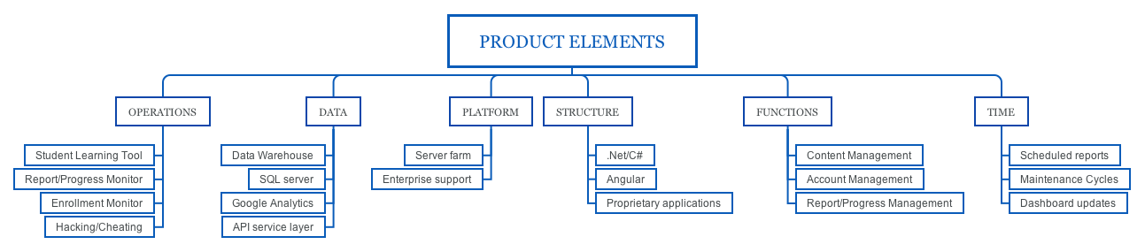
System Mapping
Notes:
Mel
I usually like to build out mind maps for these types of things. You could create one for your pipeline, tool sets, application languages, quality metrics based on functionality or areas of the application, project environment, testing techniques… anything you can identify as a process or a system, map it. You might not realize exactly what’s happening until you get a visual representation of what you are doing.

Slide 24
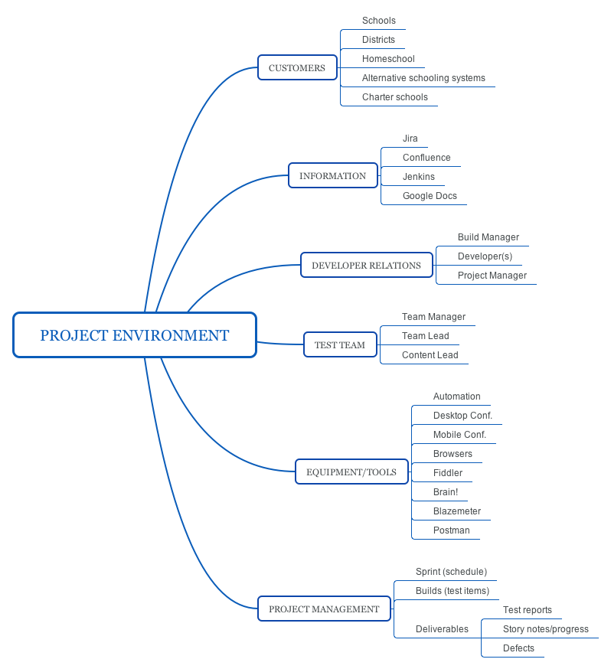
Organizational Mapping
@lisacrispin @melthetester
Notes:
Lisa
Mapping out your different teams can bring a lot of interesting questions to light. I did this recently, and noticed that there are teams of people who are also members of multiple other teams, such as testing and design. Also I noticed that 3 of our 4 managers are on one small team, the two largest teams don’t have any managers on them.

Slide 25
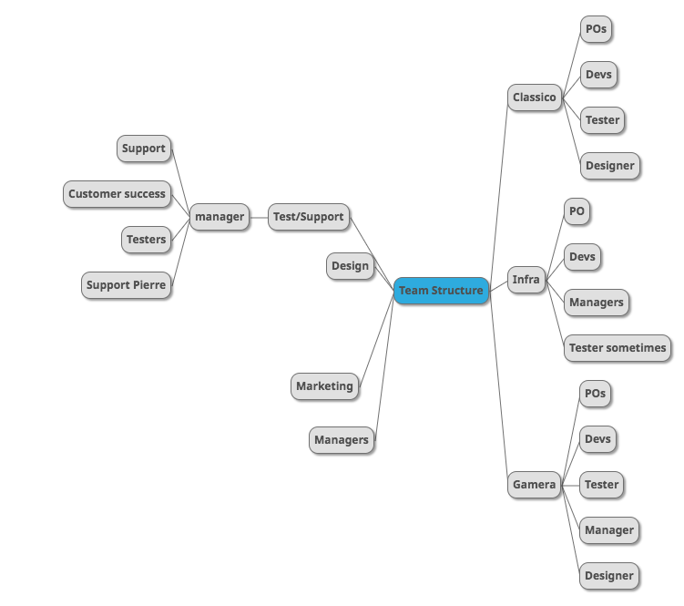
Notes:
Team Structure Example of Organizational Mapping

Slide 26
Exercise 3 / Mappings
Product team - Draw organizational maps for each exercise iteration
Delivery Team - Draw dependency maps for each exercise iteration
Use the flip chart paper
Share your maps with your partner team
How can these mappings help you gain insight and better quality applications?
Notes:
Mel
For this exercise, we’ll take 10 minutes to draw examples of these kinds of mappings. 10 minutes to share.

Slide 27
Debrief
Questions, Ideas & Observations
@lisacrispin
@melthetester
Notes:
Lisa
Debrief: Do you see any advantages for one system design over another?
What value do you see in visualizing the eco systems with dependency, system, and/or organization maps?

Slide 28

What Will You Try?
How can you apply these visual tools?
What will you try first?
What do you think it will help your team achieve?
@lisacrispin @melthetester
Notes:
Mel
Ask people if they’re willing to share
Who’s interested in an open space session to practice this stuff some more?

Slide 29
Thanks!
Q & A
ANY QUESTIONS?
You can find us at
@melthetester
@lisacrispin
Notes:
Pros/Cons of different system/organizational designs.

Slide 30
Resources For Further Learning:
Full Cycle Developers At Netflix
Understanding Software Development with Vertical Slices vs Horizontal Slices
Adjusting Test Size For Large Systems With Dependency Scope
The World of Test Automation Capability

Slide 31
Help Us With Your Feedback
Notes:
How about, we give a chocolate to everyone who turns in an eval form - or, other idea for a treat? We could buy something on Sunday?

Slide 32


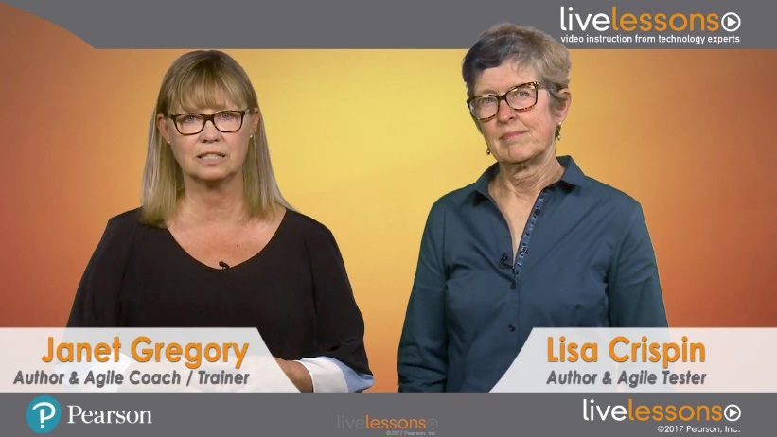


Agile Testing and More Agile Testing
Save 35%* off the books or ebooks
Agile Testing Essentials video course
Save 50%* on Agile Testing Essentials LiveLessons Video Training
Use code AGILETESTING at informit.com/agile
*Discount taken off list price. Offer only good at informit.com and is subject to change.
Notes:
Door prizes

